Slide 1
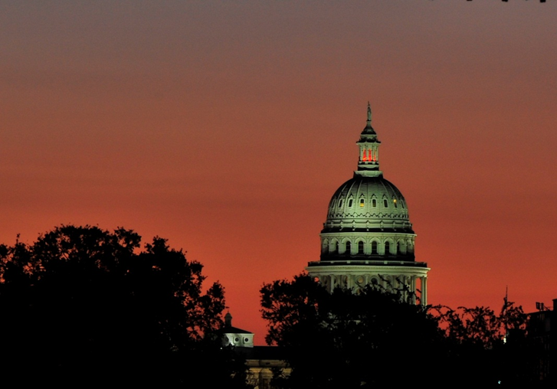
Election Updates
Keith Ingram, Director
TAEA Seminar – January 2015

Slide 2
Agenda
SOS Advisories
TEAM Redevelopment
Legislative Update
Voting Systems
Senate Bill 14 and Litigation

Slide 3
SOS Advisories
Countywide Polling Place Program:
Deadline to apply for May 9: February 23, 2015
Deadline to apply for November 3: August 20, 2015

Slide 4
TEAM Redevelopment
Project is on a very tight schedule
Focus group has had one demo and more coming
Workflow will be different
In place before 11/15 election

Slide 5
Legislative Update
The 84th Legislature will convene on Tuesday, January 13, 2015.
The inauguration for governor and lieutenant governor will occur on Tuesday, January 20, 2015.

Slide 6
Pre-filed Bills
Electronic Voter Registration:
H.B. 76 (Isreal): Requiring online registration.
H.B. 312 (Harless): Requiring online registration.
H.B. 430 (Howard): Requiring study of online registration.
H.B. 444 (Johnson): Requiring online registration.
H.B. 446 (Johnson): Allowing counties to adopt procedures for online registration.

Slide 7
Pre-filed Bills
Same Day Registration:
H.B. 111 (Fischer): Providing “same day registration” at a polling place.
H.B. 448 (Alonzo): Providing “same day registration” at a polling place.
S.B. 84 (Ellis): Providing “same day registration” at a polling place.

Slide 8
Pre-filed Bills
Voter Identification:
H.B. 295 (Canales): Adding student ID cards from higher education institution to list.
H.B. 303 (Canales): Requiring a photograph be added to registration certificates.
H.B. 447 (Johnson): Adding student ID cards from higher education institution to list.
H.B. 534 (Nevarez): Adding a photo IDs issued by an agency or institution of the state or federal government.
H.B. 535 (Nevarez): Adding photo IDs from tribal organizations.
H.B. 536 (Nevarez): Providing an expired ID is acceptable for voters over the age of 65.
S.B. 170 (Uresti): Adding photo IDs issued by high schools or higher education institutions.
S.B. 230 (Watson): Adding photo IDs issued by state agencies or state higher education institutions.

Slide 9
Pre-Filed Bills
Election Dates:
H.B. 361 (Springer): Eliminating all May uniform election dates, both odd and even years.

Slide 10
Pre-filed Bills
Other Issues:
H.B. 428 (Howard): Allowing a person who will be 18 by the general election to register and vote in the primary.
H.B. 587 (Hernandez): Requiring SOS to develop voter education program for high school seniors, and providing that CC/EAs administer program at the request of schools once per year.
S.B. 102 (Hinojosa): Adding requirements for bond election propositions.
S.B. 142 (Garcia): Providing online training for VDRs to be complete at home.
S.B. 261 (Ellis): Providing VDRs can serve throughout the state if they have been appointed in one county.

Slide 11
Voting Systems
New ES&S system certified last year
That system coming tomorrow to show it can work with previous system
EAC has three commissioners
New standards?
Legislative changes to Chapter 122?

Slide 12
Senate Bill 14
Since June 2013, we’ve had four statewide elections under Senate Bill 14. All elections have been smooth, secure and successful.
You all have done and an excellent job training poll workers and implementing changes!
THANK YOU!!!

Slide 13
Senate Bill 14
Status: On appeal to the 5th Circuit…stay tuned for potential changes.
Don‘t forget possible “bail in.”

Slide 14
What Needs Work
Reviewing Acceptable IDs
Procedures for Substantially Similar Names
Offering Provisional Ballots
Accepting IDs Without Barcodes

Slide 15
Reviewing Acceptable IDs
REMEMBER:
Addresses do not have to match between ID and OLRV. Only helps voters in the “totality of the circumstances.”
Remember that some forms of acceptable identification do not have addresses, e.g. military IDs-CACs and Uniformed Services IDs.
Remember Veterans Affairs cards are acceptable!

Slide 16
Substantially Similar Name
REMEMBER:
An exact name match is not required!
Voters with substantially similar names vote a regular ballot. They do not vote provisionally.
Name change forms are optional, and not required for voting.

Slide 17
Offering Provisional Ballots
REMEMBER:
Provisional ballots need to be offered to ALL voters!!!

Slide 18
Accepting IDs Without Barcodes
REMEMBER:
Not all forms of acceptable IDs are issued by DPS and have a barcode that can be scanned.
These IDs are still acceptable, and election workers should not be asking voters for a Texas driver’s license to avoid looking up the voter on the OLRV or e-pollbook.

Slide 19
Questions?

